Slide 1
Faltende neuronale netze
Eine Präsentation von Benjamin Jank

Slide 2
Gliederung
Übersicht über maschinelles Lernen
Reizweiterleitung in einem neuronalen Netz
Aufbau und Funktionsweise
Zweck neuronaler Netze
Training neuronaler Netze
Fehlerfunktion
Gradient Descent
Backpropagation
Funktionsweise faltender neuronaler Netze
mögliche Probleme beim Training neuronaler Netze
Vergleich zwischen neuronalen Netzen und biologischen neuronalen Netzen
Implementierung eines faltenden neuronalen Netzes
Beantwortung der Problemfrage

Slide 3
Übersicht über Maschinelles Lernen
Künstliche Intelligenz
„ist ein Teilgebiet der Informatik. Sie imitiert menschliche kognitive Fähigkeiten [...]. Diese Intelligenz kann auf programmierten Abläufen basieren oder durch maschinelles Lernen erzeugt werde.“ (Frauenhofer-Institut für Kognitive Systeme IKS)
Maschinelles Lernen
„ist ein Teilbereich der künstlichen Intelligenz (KI). Der Schwerpunkt liegt auf dem Trainieren von Computern, damit diese aus Daten und Erfahrungen lernen […] – anstatt explizit dafür programmiert zu werden.“ (SAP)
Algorithmen
Maschinelles Lernen

Slide 4
Übersicht über Maschinelles Lernen
Algorithmen
Maschinelles Lernen
Input
Input
f(x)
Zustand
f(x)
Output
Output

Slide 5
Übersicht über Maschinelles Lernen
Maschinelles Lernen
Überwachtes Lernen
Datensatz, Wahrheitswerte als Input → dem Model in mehreren Trainings präsentiert
Zustand v. Model schrittweise so verändert, dass Ausgabewerte den Wahrheitswerten annähern → Hoffnung: auf Basis dieser Anpassung des Zustandes Ausgabe für unbekannte Daten richtig → gefütterte Daten repräsentativ?
Klassifizierung
Regression
Schulterhöhe (cm) | Gewicht (kg) | Wahrheitswert
10 | 10 | 1 (Katze)
35 | 40 | 0 (Hund)
41 | 32 | 0 (Hund)
Grundstücksgröße (m²) | Hausgröße (m²) | Preis (€)
100 | 100 | 700.000
250 | 140 | 1.100.000
300 | 200 | 1.300.000

Slide 6
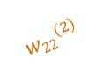
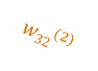
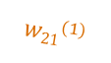
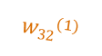
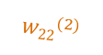
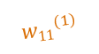
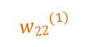
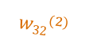
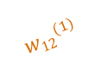
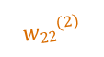
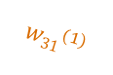
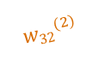
Reizweiterleitung in einem neuronalen Netz
z₁⁽²⁾ a₁⁽²⁾
$${w22}^{(2)}$$
$${w11}^{(1)}$$
$${w32}^{(2)}$$
x₁
$${w21}^{(1)}$$
z₁⁽³⁾ a₁⁽³⁾
$${w31}^{(1)}$$
$${w22}^{(2)}$$
$${w12}^{(1)}$$
z₂⁽²⁾ a₂⁽²⁾
$${w32}^{(2)}$$
$${w22}^{(1)}$$
x₂
$${w32}^{(1)}$$
z₂⁽³⁾ a₂⁽³⁾
$${w22}^{(2)}$$
$${w32}^{(2)}$$
z₃⁽²⁾ a₃⁽²⁾

Slide 7
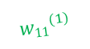
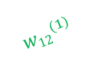
Reizweiterleitung in einem neuronalen Netz
$${z\text{1}}^{(2)}{=w11}^{(1)}x1+{w12}^{(1)}x2$$
$${\text{a}\text{1}}^{(2)}=f({z\text{1}}^{(2)})$$
z₁⁽²⁾ a₁⁽²⁾
$${w22}^{(2)}$$
$${w11}^{(1)}$$
$${w32}^{(2)}$$
x₁
$${w21}^{(1)}$$
z₁⁽³⁾ a₁⁽³⁾
$${w31}^{(1)}$$
$${w22}^{(2)}$$
$${w12}^{(1)}$$
z₂⁽²⁾ a₂⁽²⁾
$${w32}^{(2)}$$
$${w22}^{(1)}$$
x₂
$${w32}^{(1)}$$
z₂⁽³⁾ a₂⁽³⁾
$${w22}^{(2)}$$
$${w32}^{(2)}$$
z₃⁽²⁾ a₃⁽²⁾

Slide 8
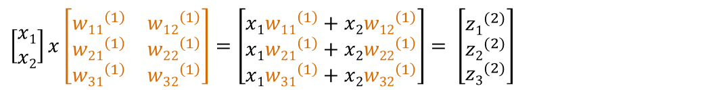
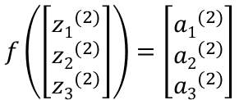
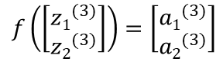
Reizweiterleitung in einem neuronalen Netz
z₁⁽²⁾ a₁⁽²⁾
$${w22}^{(2)}$$
$${w11}^{(1)}$$
$${w32}^{(2)}$$
x₁
$${w21}^{(1)}$$
z₁⁽³⁾ a₁⁽³⁾
$${w31}^{(1)}$$
$${w22}^{(2)}$$
$${w12}^{(1)}$$
z₂⁽²⁾ a₂⁽²⁾
$${w32}^{(2)}$$
$${w22}^{(1)}$$
x₂
$${w32}^{(1)}$$
z₂⁽³⁾ a₂⁽³⁾
$${w22}^{(2)}$$
$${w32}^{(2)}$$
z₃⁽²⁾ a₃⁽²⁾
$\left[\begin{matrix}x1 \\ x2\end{matrix}\right]x\left[\begin{matrix}{w11}^{\left(1\right)} & {w12}^{\left(1\right)} \\ {w21}^{\left(1\right)} & {w22}^{\left(1\right)} \\ {w31}^{\left(1\right)} & {w32}^{\left(1\right)}\end{matrix}\right]$ $=\left[\begin{matrix}x1{w11}^{\left(1\right)}+x2{w12}^{\left(1\right)} \\ x1{w21}^{\left(1\right)}+x2{w22}^{\left(1\right)} \\ x1{w31}^{\left(1\right)}+x2{w32}^{\left(1\right)}\end{matrix}\right]$ $= \left[\begin{matrix}{z1}^{(2)} \\ {z2}^{(2)} \\ {z3}^{(2)}\end{matrix}\right]$
$$f\left(\left[\begin{matrix}{z1}^{(2)} \\ {z2}^{(2)} \\ {z3}^{(2)}\end{matrix}\right]\right)=\left[\begin{matrix}{a1}^{(2)} \\ {a2}^{(2)} \\ {a3}^{(2)}\end{matrix}\right]$$
$\left[\begin{matrix}{a1}^{\left(2\right)} \\ {a2}^{\left(2\right)} \\ {a3}^{\left(2\right)}\end{matrix}\right]x\left[\begin{matrix}{w11}^{\left(2\right)} & {w12}^{\left(2\right)} & {w13}^{\left(2\right)} \\ {w21}^{\left(2\right)} & {w22}^{\left(2\right)} & {w23}^{\left(2\right)}\end{matrix}\right]=\left[\begin{matrix}{a1}^{\left(2\right)}{w11}^{\left(2\right)}+{a2}^{\left(2\right)}{w12}^{\left(2\right)}+{a3}^{\left(2\right)}{w13}^{\left(2\right)} \\ {a1}^{\left(2\right)}{w21}^{\left(2\right)}+{a2}^{\left(2\right)}{w22}^{\left(2\right)}+{a3}^{\left(2\right)}{w23}^{\left(2\right)}\end{matrix}\right]$ $= \left[\begin{matrix}{z1}^{(3)} \\ {z2}^{(3)}\end{matrix}\right]$
$$f\left(\left[\begin{matrix}{z1}^{(3)} \\ {z2}^{(3)}\end{matrix}\right]\right)=\left[\begin{matrix}{a1}^{(3)} \\ {a2}^{(3)}\end{matrix}\right]$$

Slide 9
Anwendung von neuronalen Netzen
Einsatz bei Datenmodellierung
Bei einfachen Ansätzen (z.B. f(x)=ax+b) sehr limitiert
Neuronale Netze: komplexe Funktion → verschachtelte Funktionen mit einer Vielzahl an Parametern ➔ jede Funktion annähernd darstellbar

Slide 10
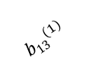
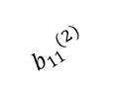
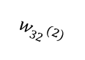
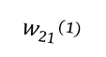
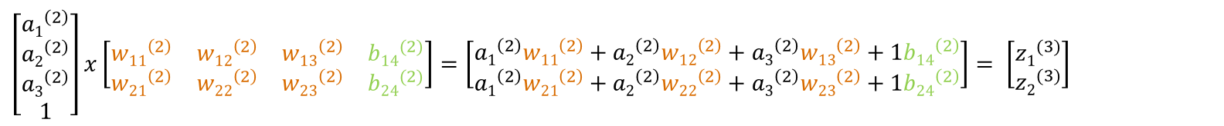
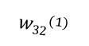
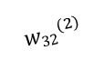
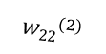
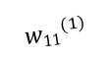
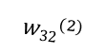
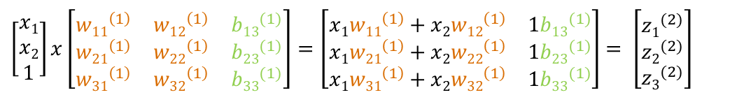
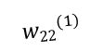
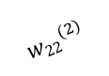
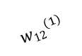
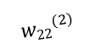
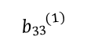
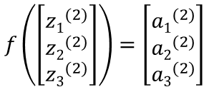
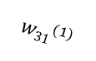
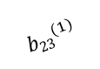
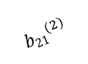
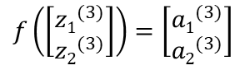
Ein künstliches neuronales Netz
z₁⁽²⁾ a₁⁽²⁾
$${w22}^{(2)}$$
$${w11}^{(1)}$$
$${w32}^{(2)}$$
x₁
$${w21}^{(1)}$$
z₁⁽³⁾ a₁⁽³⁾
$${w31}^{(1)}$$
$${w22}^{(2)}$$
$${w12}^{(1)}$$
z₂⁽²⁾ a₂⁽²⁾
$${w32}^{(2)}$$
$${w22}^{(1)}$$
x₂
$${w32}^{(1)}$$
z₂⁽³⁾ a₂⁽³⁾
$${w22}^{(2)}$$
$${b13}^{(1)}$$
$${w32}^{(2)}$$
$${b23}^{(1)}$$
z₃⁽²⁾ a₃⁽²⁾
₁
$${b33}^{(1)}$$
$${b11}^{(2)}$$
$${b21}^{(2)}$$
₁
$\left[\begin{matrix}x1 \\ x2 \\ 1\end{matrix}\right]x\left[\begin{matrix}{w11}^{\left(1\right)} & {w12}^{\left(1\right)} & {b13}^{(1)} \\ {w21}^{\left(1\right)} & {w22}^{\left(1\right)} & {b23}^{(1)} \\ {w31}^{\left(1\right)} & {w32}^{\left(1\right)} & {b33}^{(1)}\end{matrix}\right]$ $=\left[\begin{matrix}x1{w11}^{\left(1\right)}+x2{w12}^{\left(1\right)} & 1{b13}^{(1)} \\ x1{w21}^{\left(1\right)}+x2{w22}^{\left(1\right)} & 1{b23}^{(1)} \\ x1{w31}^{\left(1\right)}+x2{w32}^{\left(1\right)} & 1{b33}^{(1)}\end{matrix}\right]$ $= \left[\begin{matrix}{z1}^{(2)} \\ {z2}^{(2)} \\ {z3}^{(2)}\end{matrix}\right]$
$$f\left(\left[\begin{matrix}{z1}^{(2)} \\ {z2}^{(2)} \\ {z3}^{(2)}\end{matrix}\right]\right)=\left[\begin{matrix}{a1}^{(2)} \\ {a2}^{(2)} \\ {a3}^{(2)}\end{matrix}\right]$$
$\left[\begin{matrix}{a1}^{\left(2\right)} \\ {a2}^{\left(2\right)} \\ {a3}^{\left(2\right)} \\ 1\end{matrix}\right]x\left[\begin{matrix}{w11}^{\left(2\right)} & {w12}^{\left(2\right)} & {w13}^{\left(2\right)} & {b14}^{(2)} \\ {w21}^{\left(2\right)} & {w22}^{\left(2\right)} & {w23}^{\left(2\right)} & {b24}^{(2)}\end{matrix}\right]=\left[\begin{matrix}{a1}^{\left(2\right)}{w11}^{\left(2\right)}+{a2}^{\left(2\right)}{w12}^{\left(2\right)}+{a3}^{\left(2\right)}{w13}^{\left(2\right)}+1{b14}^{\left(2\right)} \\ {a1}^{\left(2\right)}{w21}^{\left(2\right)}+{a2}^{\left(2\right)}{w22}^{\left(2\right)}+{a3}^{\left(2\right)}{w23}^{\left(2\right)}+1{b24}^{\left(2\right)}\end{matrix}\right]$ $= \left[\begin{matrix}{z1}^{(3)} \\ {z2}^{(3)}\end{matrix}\right]$
$$f\left(\left[\begin{matrix}{z1}^{(3)} \\ {z2}^{(3)}\end{matrix}\right]\right)=\left[\begin{matrix}{a1}^{(3)} \\ {a2}^{(3)}\end{matrix}\right]$$

Slide 11
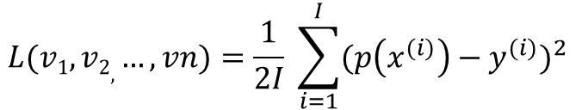
Training neuronaler Netze
Die Fehlerfunktion
Parameter von Model als Eingabe
Gibt Abweichung des Models von Wahrheitswerten zurück
Mean Squared Error Funktion:
Das Gradientenverfahren
Iterativer Algorithmus, um differenzierbare Funktion zu minimieren
Hilfsmittel, um Fehlerfunktion zu optimieren
$$L(v1, v2, …, vn)=\frac{1}{2I} \sum_{i=1}^{I}{{(p\left(x^{(i)}\right)−y^{(i)})}^{2} }$$

Slide 12
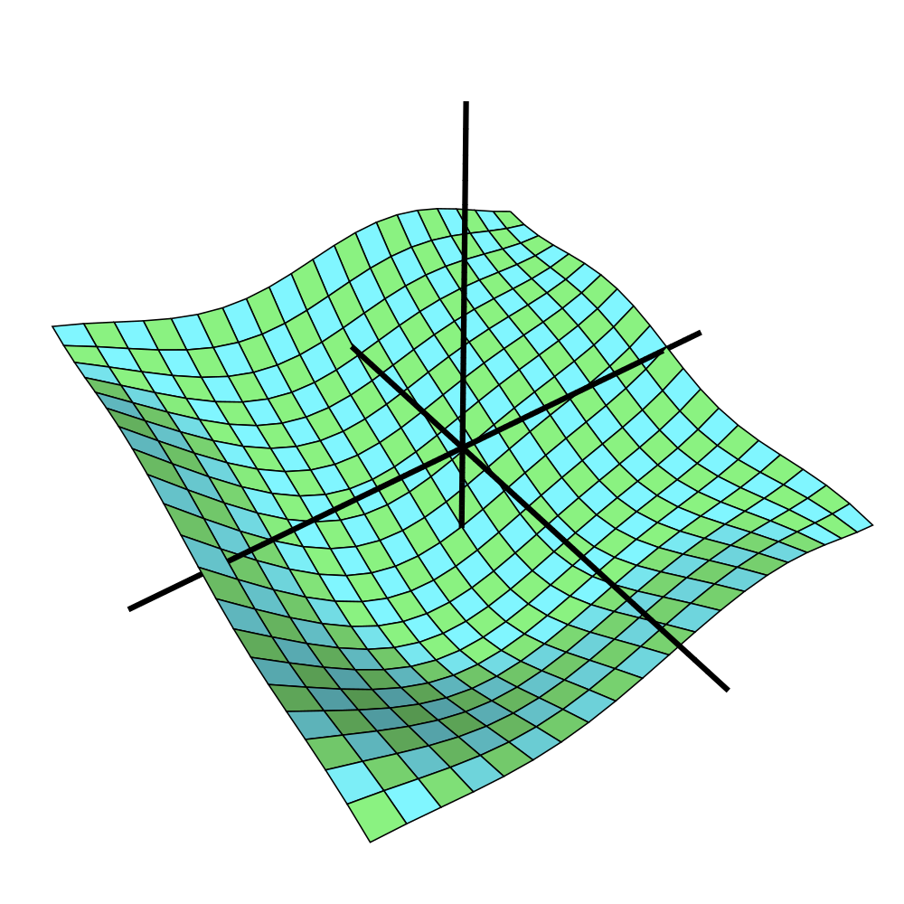
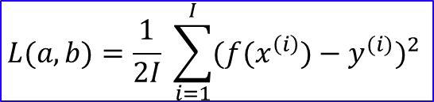

Training neuronaler Netze
$$f\left(x\right)=ax+b$$
$$L(a, b)=\frac{1}{2I} \sum_{i=1}^{I}{{({f(x}^{\left(i\right)})−y^{(i)})}^{2} }$$
L
a
b
x P

Slide 13
Training neuronaler Netze
$$f\left(x\right)=ax+b$$
$$L(a, b)=\frac{1}{2I} \sum_{i=1}^{I}{{({f(x}^{\left(i\right)})−y^{(i)})}^{2} }$$
L
x P
a
b

Slide 14
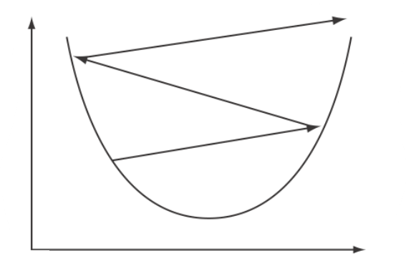
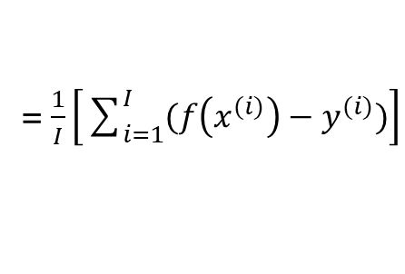
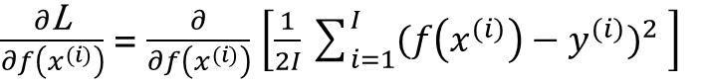
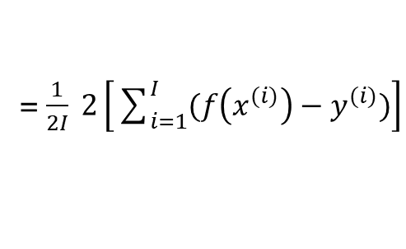


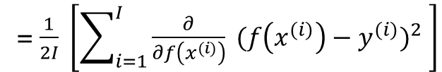
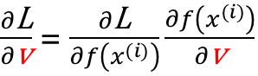
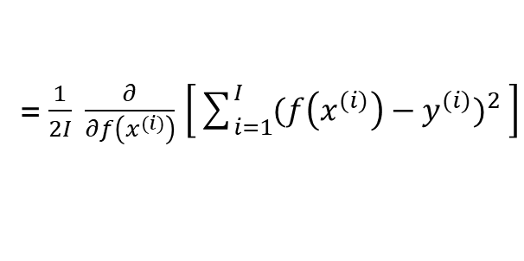
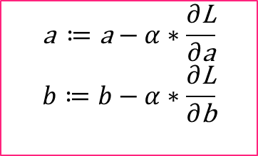
Training neuronaler Netze
$$f\left(x\right)=ax+b$$
$$L(a, b)=\frac{1}{2I} \sum_{i=1}^{I}{{({f(x}^{\left(i\right)})−y^{(i)})}^{2} }$$
$$\text{a} ≔\text{a}−α∗\frac{∂\text{L}}{∂\text{a}} \\ b≔b−α∗\frac{∂\text{L}}{∂\text{b}}$$
Wichtige Bezeichnungen
$\frac{∂\text{L}}{∂\text{v}}$ = $\frac{∂\text{L}}{∂f\left(x^{(i)}\right)}\frac{∂f\left(x^{(i)}\right)}{∂\text{v}}$
$\frac{∂\text{L}}{∂f\left(x^{(i)}\right)}$ = $\frac{∂}{∂f\left(x^{(i)}\right)}$ $\left[\frac{1}{2I}\sum_{i=1}^{I}{{(f\left(x^{(i)}\right)−y^{(i)})}^{2} }\right]$
= $\frac{1}{2I} \frac{∂}{∂f\left(x^{(i)}\right)}$ $\left[\sum_{i=1}^{I}{{(f\left(x^{(i)}\right)−y^{(i)})}^{2} }\right]$
= $\frac{1}{2I} \left[\sum_{i=1}^{I}{{\frac{∂}{∂f\left(x^{(i)}\right)} (f\left(x^{(i)}\right)−y^{(i)})}^{2} }\right]$
= $\frac{1}{2I} \left[\sum_{i=1}^{I}{2(f\left(x^{(i)}\right)−y^{(i)})}∗\frac{∂}{∂f\left(x^{(i)}\right)} (f\left(x^{(i)}\right)−y^{(i)})\right]$
x P
= $\frac{1}{2I} 2\left[\sum_{i=1}^{I}{(f\left(x^{(i)}\right)−y^{(i)})}\right]$
= $\frac{1}{I}\left[\sum_{i=1}^{I}{(f\left(x^{(i)}\right)−y^{(i)})}\right]$

Slide 15
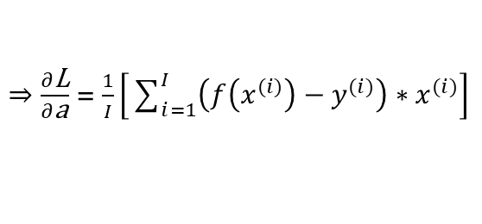




Training neuronaler Netze
$$f\left(x\right)=ax+b$$
$$L(a, b)=\frac{1}{2I} \sum_{i=1}^{I}{{({f(x}^{\left(i\right)})−y^{(i)})}^{2} }$$
$$\text{a} ≔\text{a}−α∗\frac{∂\text{L}}{∂\text{a}} \\ b≔b−α∗\frac{∂\text{L}}{∂\text{b}}$$
Wichtige Bezeichnungen
$\frac{∂\text{L}}{∂\text{v}}$ = $\frac{∂\text{L}}{∂f\left(x^{(i)}\right)}\frac{∂f\left(x^{(i)}\right)}{∂\text{v}}$
$$\frac{∂\text{L}}{∂\text{v}}=\frac{1}{I}\left[\sum_{i=1}^{I}{(f\left(x^{(i)}\right)−y^{(i)})}\right]\frac{∂{f(x}^{\left(i\right)})}{∂\text{v}}$$
$$=\frac{1}{I}\left[\sum_{i=1}^{I}{(f\left(x^{(i)}\right)−y^{(i)})}\frac{∂{f(x}^{\left(i\right)}}{∂\text{v}}\right]$$
$⇒\frac{∂\text{L}}{∂\text{b}}$ = $\frac{1}{I}\left[\sum_{i=1}^{I}{(f\left(x^{(i)}\right)−y^{(i)})}\right]$
x P
$⇒\frac{∂\text{L}}{∂\text{a}}$ = $\frac{1}{I}\left[\sum_{i=1}^{I}{\left(f\left(x^{(i)}\right)−y^{(i)}\right)∗x^{(i)}}\right]$

Slide 16











Training neuronaler Netze
$\left[\begin{matrix}x1 \\ x2 \\ 1\end{matrix}\right]x\left[\begin{matrix}{w11}^{\left(1\right)} & {w12}^{\left(1\right)} & {b13}^{(1)} \\ {w21}^{\left(1\right)} & {w22}^{\left(1\right)} & {b23}^{(1)} \\ {w31}^{\left(1\right)} & {w32}^{\left(1\right)} & {b33}^{(1)}\end{matrix}\right]$ $=\left[\begin{matrix}x1{w11}^{\left(1\right)}+x2{w12}^{\left(1\right)} & 1{b13}^{(1)} \\ x1{w21}^{\left(1\right)}+x2{w22}^{\left(1\right)} & 1{b23}^{(1)} \\ x1{w31}^{\left(1\right)}+x2{w32}^{\left(1\right)} & 1{b33}^{(1)}\end{matrix}\right]$ $= \left[\begin{matrix}{z1}^{(2)} \\ {z2}^{(2)} \\ {z3}^{(2)}\end{matrix}\right]$
$$σ\left(\left[\begin{matrix}{z1}^{(2)} \\ {z2}^{(2)} \\ {z3}^{(2)}\end{matrix}\right]\right)=\left[\begin{matrix}{a1}^{(2)} \\ {a2}^{(2)} \\ {a3}^{(2)}\end{matrix}\right]$$
$\left[\begin{matrix}{a1}^{\left(2\right)} \\ {a2}^{\left(2\right)} \\ {a3}^{\left(2\right)} \\ 1\end{matrix}\right]x\left[\begin{matrix}{w11}^{\left(2\right)} & {w12}^{\left(2\right)} & {w13}^{\left(2\right)} & {b14}^{(2)} \\ {w21}^{\left(2\right)} & {w22}^{\left(2\right)} & {w23}^{\left(2\right)} & {b24}^{(2)}\end{matrix}\right]=\left[\begin{matrix}{a1}^{\left(2\right)}{w11}^{\left(2\right)}+{a2}^{\left(2\right)}{w12}^{\left(2\right)}+{a3}^{\left(2\right)}{w13}^{\left(2\right)}+1{b14}^{\left(2\right)} \\ {a1}^{\left(2\right)}{w21}^{\left(2\right)}+{a2}^{\left(2\right)}{w22}^{\left(2\right)}+{a3}^{\left(2\right)}{w23}^{\left(2\right)}+1{b24}^{\left(2\right)}\end{matrix}\right]$ $= \left[\begin{matrix}{z1}^{(3)} \\ {z2}^{(3)}\end{matrix}\right]$
$$f\left(\left[\begin{matrix}{z1}^{(3)} \\ {z2}^{(3)}\end{matrix}\right]\right)=\left[\begin{matrix}{a1}^{(3)} \\ {a2}^{(3)}\end{matrix}\right]$$
$$L(w1, b)=\frac{1}{2I} \sum_{i=1}^{I}{{({al}^{(3)(i)}−{yl}^{(i)})}^{2} }$$
$${\text{w}lk}^{(2)}≔{\text{w}lk}^{(2)}−α∗\frac{∂\text{L}}{∂{\text{w}lk}^{(2)}}\text{;}{ \text{b}l4}^{(2)}≔{\text{b}l4}^{(2)}−α∗\frac{∂\text{L}}{∂{\text{b}l4}^{(2)}}$$
$$\frac{∂\text{L}}{∂{\text{v}lk}^{(2)}}=\frac{1}{I}\left[\sum_{i=1}^{I}{({al}^{(3)(i)}−y^{(i)})}∗f({al}^{(3)(i)})\left(1−f({al}^{(3)(i)})\right)∗\frac{{zl}^{(3)(i)}}{∂{\text{v}lk}^{(2)}}\right]$$
$\frac{∂\text{L}}{∂{\text{v}lk}^{(2)}}=\frac{∂\text{L}}{∂{al}^{(3)(i)}}\frac{∂{al}^{(3)(i)}}{∂{zl}^{(3)(i)}}$ $\frac{{zl}^{(3)(i)}}{∂{\text{v}lk}^{(2)}}$
$$\frac{∂\text{L}}{∂{al}^{(3)(i)}}=\frac{1}{I}\left[\sum_{i=1}^{I}{(∂{al}^{(3)(i)}−y^{(i)})}\right]$$
$⇒\frac{∂\text{L}}{∂{wlk}^{\left(2\right)}}$ = $\frac{1}{I}\left[\sum_{i=1}^{I}{({al}^{(3)(i)}−y^{(i)})}∗f({al}^{(3)(i)})\left(1−f({al}^{(3)(i)})\right)∗{ak}^{\left(2\right)}\right]$
$$\frac{∂{al}^{(3)(i)}}{∂{zl}^{(3)(i)}}=\frac{∂}{∂{zl}^{(3)(i)}}{f(zl}^{(3)(i)})={f(zl}^{(3)(i)})∗(1−{f(zl}^{(3)(i)})$$
$⇒\frac{∂\text{L}}{∂{bl4}^{\left(2\right)}}$ = $\frac{1}{I}\left[\sum_{i=1}^{I}{({al}^{(3)(i)}−y^{(i)})}∗f({al}^{(3)(i)})\left(1−f({al}^{(3)(i)})\right)∗1\right]$
$\frac{∂{zl}^{(3)(i)}}{∂{\text{v}lk}^{(2)}}=$ $\frac{∂}{∂{\text{v}lk}^{(2)}} \left({a1}^{\left(2\right)(i)}{wl1}^{\left(2\right)}+{a2}^{\left(2\right)(i)}{wl2}^{\left(2\right)}+{a3}^{\left(2\right)(i)}{wl3}^{\left(2\right)}+1{bl4}^{\left(2\right)}\right)$
$$\frac{∂\text{L}}{∂{\text{v}lk}^{(2)}}=\frac{1}{I}\left[\sum_{i=1}^{I}{({al}^{(3)(i)}−y^{(i)})}\right]∗f({al}^{(3)(i)})\left(1−f({al}^{(3)(i)})\right)∗\frac{{zl}^{(3)(i)}}{∂{\text{v}lk}^{(2)}}$$

Slide 17






Training neuronaler Netze
$\left[\begin{matrix}x1 \\ x2 \\ 1\end{matrix}\right]x\left[\begin{matrix}{w11}^{\left(1\right)} & {w12}^{\left(1\right)} & {b13}^{(1)} \\ {w21}^{\left(1\right)} & {w22}^{\left(1\right)} & {b23}^{(1)} \\ {w31}^{\left(1\right)} & {w32}^{\left(1\right)} & {b33}^{(1)}\end{matrix}\right]$ $=\left[\begin{matrix}x1{w11}^{\left(1\right)}+x2{w12}^{\left(1\right)} & 1{b13}^{(1)} \\ x1{w21}^{\left(1\right)}+x2{w22}^{\left(1\right)} & 1{b23}^{(1)} \\ x1{w31}^{\left(1\right)}+x2{w32}^{\left(1\right)} & 1{b33}^{(1)}\end{matrix}\right]$ $= \left[\begin{matrix}{z1}^{(2)} \\ {z2}^{(2)} \\ {z3}^{(2)}\end{matrix}\right]$
$$f\left(\left[\begin{matrix}{z1}^{(2)} \\ {z2}^{(2)} \\ {z3}^{(2)}\end{matrix}\right]\right)=\left[\begin{matrix}{a1}^{(2)} \\ {a2}^{(2)} \\ {a3}^{(2)}\end{matrix}\right]$$
$\left[\begin{matrix}{a1}^{\left(2\right)} \\ {a2}^{\left(2\right)} \\ {a3}^{\left(2\right)} \\ 1\end{matrix}\right]x\left[\begin{matrix}{w11}^{\left(2\right)} & {w12}^{\left(2\right)} & {w13}^{\left(2\right)} & {b14}^{(2)} \\ {w21}^{\left(2\right)} & {w22}^{\left(2\right)} & {w23}^{\left(2\right)} & {b24}^{(2)}\end{matrix}\right]=\left[\begin{matrix}{a1}^{\left(2\right)}{w11}^{\left(2\right)}+{a2}^{\left(2\right)}{w12}^{\left(2\right)}+{a3}^{\left(2\right)}{w13}^{\left(2\right)}+1{b14}^{\left(2\right)} \\ {a1}^{\left(2\right)}{w21}^{\left(2\right)}+{a2}^{\left(2\right)}{w22}^{\left(2\right)}+{a3}^{\left(2\right)}{w23}^{\left(2\right)}+1{b24}^{\left(2\right)}\end{matrix}\right]$ $= \left[\begin{matrix}{z1}^{(3)} \\ {z2}^{(3)}\end{matrix}\right]$
$$f\left(\left[\begin{matrix}{z1}^{(3)} \\ {z2}^{(3)}\end{matrix}\right]\right)=\left[\begin{matrix}{a1}^{(3)} \\ {a2}^{(3)}\end{matrix}\right]$$
$$L(w1, b)=\frac{1}{2I} \sum_{i=1}^{I}{{({al}^{(3)(i)}−{yl}^{(i)})}^{2} }$$
$${\text{w}kj}^{(1)}≔{\text{w}kj}^{(1)}−α∗\frac{∂\text{L}}{∂{\text{w}kj}^{(1)}}\text{;}{ \text{b}k3}^{(1)}≔{ \text{b}k3}^{(1)}−α∗\frac{∂\text{L}}{{ \text{b}k3}^{(1)}}$$
$$\frac{∂\text{L}}{∂{\text{v}kj}^{(1)}}=\frac{∂\text{L}}{∂{al}^{(3)(i)}}\frac{∂{al}^{(3)(i)}}{∂{zl}^{(3)(i)}}\frac{∂{zl}^{(3)(i)}}{∂{ak}^{(2)(i)}}\frac{∂{ak}^{(2)(i)}}{∂{zk}^{\left(2\right)\left(i\right)}}\frac{{∂zk}^{\left(2\right)\left(i\right)}}{∂{\text{v}kj}^{(1)}}$$
$$\frac{{∂zl}^{(3)(i)}}{∂{ak}^{(2)(i)}}=\frac{∂}{∂{ak}^{(2)(i)}}\left({a1}^{\left(2\right)(i)}{wl1}^{\left(2\right)}+{a2}^{\left(2\right)(i)}{wl2}^{\left(2\right)}+{a3}^{\left(2\right)(i)}{wl3}^{\left(2\right)}+1{bl4}^{\left(2\right)}\right)={wlk}^{(2)}$$
$$\frac{∂{ak}^{(2)(i)}}{∂{zk}^{\left(2\right)\left(i\right)}}=\frac{∂}{{∂zk}^{\left(2\right)\left(i\right)}}σ({zk}^{\left(2\right)\left(i\right)})=σ\left({zk}^{\left(2\right)\left(i\right)}\right)∗\left(1−σ\left({zk}^{\left(2\right)\left(i\right)}\right)\right)$$
$$\frac{{∂zk}^{\left(2\right)\left(i\right)}}{∂{\text{v}kj}^{(1)}}=\frac{∂}{∂{\text{v}kj}^{(1)}}\left(x1{wk1}^{\left(1\right)}+x2{wk2}^{\left(1\right)}+1{bk4}^{\left(1\right)}\right)$$
$$\frac{∂\text{L}}{∂{\text{v}kj}^{(1)}}=\frac{1}{I}\left[\sum_{i=1}^{I}{({al}^{(3)(i)}−y^{(i)})}\right]∗f({al}^{(3)(i)})\left(1−f({al}^{(3)(i)})\right)∗{wlk}^{\left(2\right)}∗σ\left({zk}^{\left(2\right)\left(i\right)}\right)\left(1−σ\left({zk}^{\left(2\right)\left(i\right)}\right)\right)∗\frac{∂}{∂{\text{v}kj}^{(1)}}\left(x1{wk1}^{\left(1\right)}+x2{wk2}^{\left(1\right)}+1{bk4}^{\left(1\right)}\right)$$

Slide 18





Training neuronaler Netze
$\left[\begin{matrix}x1 \\ x2 \\ 1\end{matrix}\right]x\left[\begin{matrix}{w11}^{\left(1\right)} & {w12}^{\left(1\right)} & {b13}^{(1)} \\ {w21}^{\left(1\right)} & {w22}^{\left(1\right)} & {b23}^{(1)} \\ {w31}^{\left(1\right)} & {w32}^{\left(1\right)} & {b33}^{(1)}\end{matrix}\right]$ $=\left[\begin{matrix}x1{w11}^{\left(1\right)}+x2{w12}^{\left(1\right)} & 1{b13}^{(1)} \\ x1{w21}^{\left(1\right)}+x2{w22}^{\left(1\right)} & 1{b23}^{(1)} \\ x1{w31}^{\left(1\right)}+x2{w32}^{\left(1\right)} & 1{b33}^{(1)}\end{matrix}\right]$ $= \left[\begin{matrix}{z1}^{(2)} \\ {z2}^{(2)} \\ {z3}^{(2)}\end{matrix}\right]$
$$σ\left(\left[\begin{matrix}{z1}^{(2)} \\ {z2}^{(2)} \\ {z3}^{(2)}\end{matrix}\right]\right)=\left[\begin{matrix}{a1}^{(2)} \\ {a2}^{(2)} \\ {a3}^{(2)}\end{matrix}\right]$$
$\left[\begin{matrix}{a1}^{\left(2\right)} \\ {a2}^{\left(2\right)} \\ {a3}^{\left(2\right)} \\ 1\end{matrix}\right]x\left[\begin{matrix}{w11}^{\left(2\right)} & {w12}^{\left(2\right)} & {w13}^{\left(2\right)} & {b14}^{(2)} \\ {w21}^{\left(2\right)} & {w22}^{\left(2\right)} & {w23}^{\left(2\right)} & {b24}^{(2)}\end{matrix}\right]=\left[\begin{matrix}{a1}^{\left(2\right)}{w11}^{\left(2\right)}+{a2}^{\left(2\right)}{w12}^{\left(2\right)}+{a3}^{\left(2\right)}{w13}^{\left(2\right)}+1{b14}^{\left(2\right)} \\ {a1}^{\left(2\right)}{w21}^{\left(2\right)}+{a2}^{\left(2\right)}{w22}^{\left(2\right)}+{a3}^{\left(2\right)}{w23}^{\left(2\right)}+1{b24}^{\left(2\right)}\end{matrix}\right]$ $= \left[\begin{matrix}{z1}^{(3)} \\ {z2}^{(3)}\end{matrix}\right]$
$$f\left(\left[\begin{matrix}{z1}^{(3)} \\ {z2}^{(3)}\end{matrix}\right]\right)=\left[\begin{matrix}{a1}^{(3)} \\ {a2}^{(3)}\end{matrix}\right]$$
$$L(w1, b)=\frac{1}{2I} \sum_{i=1}^{I}{{({al}^{(3)(i)}−{yl}^{(i)})}^{2} }$$
$${\text{w}kj}^{(1)}≔{\text{w}kj}^{(1)}−α∗\frac{∂\text{L}}{∂{\text{w}kj}^{(1)}}\text{;}{ \text{b}k3}^{(1)}≔{ \text{b}k3}^{(1)}−α∗\frac{∂\text{L}}{{ \text{b}k3}^{(1)}}$$
$$\frac{∂\text{L}}{∂{\text{v}kj}^{(1)}}=\frac{1}{I}\left[\sum_{i=1}^{I}{({al}^{(3)(i)}−y^{(i)})}\right]∗f({al}^{(3)(i)})\left(1−f({al}^{(3)(i)})\right)∗{wlk}^{\left(2\right)}∗σ\left({zk}^{\left(2\right)\left(i\right)}\right)\left(1−σ\left({zk}^{\left(2\right)\left(i\right)}\right)\right)∗\frac{∂}{∂{\text{v}kj}^{(1)}}\left(x1{wk1}^{\left(1\right)}+x2{wk2}^{\left(1\right)}+1{bk4}^{\left(1\right)}\right)$$
$⇒\frac{∂\text{L}}{∂{wkj}^{\left(1\right)}}$ =$\frac{1}{I}\left[\sum_{i=1}^{I}{({al}^{(3)(i)}−y^{(i)})∗f({al}^{(3)(i)})\left(1−f({al}^{(3)(i)})\right)}∗{wlk}^{\left(2\right)}∗σ\left({zk}^{\left(2\right)\left(i\right)}\right)∗\left(1−σ\left({zk}^{\left(2\right)\left(i\right)}\right)\right)∗xj\right]$
$⇒\frac{∂\text{L}}{∂{bk3}^{\left(1\right)}}$ =$⇒\frac{∂\text{L}}{∂{wkj}^{\left(1\right)}}\text{ =}\frac{1}{I}\left[\sum_{i=1}^{I}{({al}^{(3)(i)}−y^{(i)})∗f({al}^{(3)(i)})\left(1−f({al}^{(3)(i)})\right)}∗{wlk}^{\left(2\right)}∗σ\left({zk}^{\left(2\right)\left(i\right)}\right)∗\left(1−σ\left({zk}^{\left(2\right)\left(i\right)}\right)\right)∗1\right]$

Slide 19

Training neuronaler Netze
z₁⁽²⁾ a₁⁽²⁾
$${w22}^{(2)}$$
$${w11}^{(1)}$$
$${w32}^{(2)}$$
y
x₁
$${w21}^{(1)}$$
z₁⁽³⁾ a₁⁽³⁾
$${w31}^{(1)}$$
$${w22}^{(2)}$$
$${w12}^{(1)}$$
z₂⁽²⁾ a₂⁽²⁾
$${w32}^{(2)}$$
$${w22}^{(1)}$$
x₂
$${w32}^{(1)}$$
z₂⁽³⁾ a₂⁽³⁾
$${w22}^{(2)}$$
$${b13}^{(1)}$$
$${w32}^{(2)}$$
$${b23}^{(1)}$$
z₃⁽²⁾ a₃⁽²⁾
₁
$${b33}^{(1)}$$
$${b11}^{(2)}$$
$${b21}^{(2)}$$
₁
for l in range(L):
for k in range(K):
$$\frac{∂\text{L}}{∂{wlk}^{\left(2\right)}}=:\frac{∂\text{L}}{∂{wlk}^{\left(2\right)}}−α∗ \frac{1}{I}\left[\sum_{i=1}^{I}{{ al}^{(3)(i)}−{yl}^{\left(i\right)})∗f({al}^{\left(3\right)\left(i\right)})\left(1−f\left({al}^{\left(3\right)\left(i\right)}\right)\right)∗{ak}^{\left(2\right)}}\right]$$
for l in range(L):
for k in range(K):
for j in range(J):
$$\frac{∂\text{L}}{∂{wkj}^{\left(1\right)}}≔\frac{∂\text{L}}{∂{wkj}^{\left(1\right)}}−α∗\frac{1}{I}\left[\sum_{i=1}^{I}{({al}^{(3)(i)}−{yl}^{(i)})∗f({al}^{(3)(i)})\left(1−f({al}^{(3)(i)})\right)∗{wlk}^{\left(2\right)}∗σ\left({zk}^{\left(2\right)\left(i\right)}\right)∗\left(1−σ\left({zk}^{\left(2\right)\left(i\right)}\right)\right)∗xj}\right]$$

Slide 20

















Ein faltendes neuronales Netz
z₁⁽²⁾ a₁⁽²⁾
$${w22}^{(2)}$$
$${w11}^{(1)}$$
$${w32}^{(2)}$$
x₁
$${w21}^{(1)}$$
z₁⁽³⁾ a₁⁽³⁾
$${w31}^{(1)}$$
$${w22}^{(2)}$$
$${w12}^{(1)}$$
z₂⁽²⁾ a₂⁽²⁾
$${w32}^{(2)}$$
x₂
$${w22}^{(1)}$$
$${w32}^{(1)}$$
z₂⁽³⁾ a₂⁽³⁾
$${w22}^{(2)}$$
$${b13}^{(1)}$$
$${w32}^{(2)}$$
$${b23}^{(1)}$$
z₃⁽²⁾ a₃⁽²⁾
₁
$${b33}^{(1)}$$
$${b11}^{(2)}$$
$${b21}^{(2)}$$
₁
faltende
Schicht
faltende
Schicht

Slide 21







Ein faltendes neuronales Netz
$$\left[\begin{matrix}12 & 9 & 12 \\ 6 & 12 & 9 \\ 6 & 9 & 12\end{matrix}\right]$$
$$f\left(\left[\begin{matrix}12 & 9 & 12 \\ 6 & 12 & 9 \\ 6 & 9 & 12\end{matrix}\right]\right)$$
$$\left[\begin{matrix}12 & 9 & 12 \\ 6 & 12 & 9 \\ 6 & 9 & 12\end{matrix}\right]$$
$$\left[\begin{matrix}12 & 12 \\ 12 & 12\end{matrix}\right]$$
Dimensionen von Fenster: 2x2
→ Max-Pooling
→ Durchschnitt-Pooling
Faltungs-Schritt (Convolution)
Aktivierungsfunktion
Pooling

Slide 22


Mögliche Probleme
Overshooting
über Minimum hinausschießen
identifizierbar durch Beobachtung des Fehlers während des Trainings
2. Vanishing Gradient Problem
bei vielen Aktivierungsfunktionen: Steigung für sehr große/kleine Werte sehr klein
resultierender Wert für Optimierung von Parametern sehr klein
3. Overfitting
Model bildet zu genau Lage v. Trainingsdaten ab
Generalisierung nicht möglich
x P

Slide 23


Vergleich biologischer und künstlicher neuronaler Netze
Kriterium | Neuronale Netze | Biologische neuronale Netze
Summation der postsynaptischen Potenziale | räumlich | räumlich, zeitlich
Art der Reizweiterleitung | kontinuierlich | binär
Struktur | regelmäßig, Anordnung in Schichten | Komplexes, unregelmäßiges Netz
Art der neuronalen Plastizität | funktionale Plastizität | funktionale, strukturelle Plastizität
Anzahl Neuronen | wenige Neuronen (10 bis 10.000) | sehr viele Neuronen (ca. 100 Mrd. in ZNS)

Slide 24

Eigene Implementierung
Br35H :: Brain Tumor Detection 2020 von Kaggle-Datenbank

Slide 25



Eigene Implementierung

Slide 26

Eigene Implementierung

Slide 27

Eigene Implementierung

Slide 28


Eigene Implementierung
Genauigkeit
mittlerer quadrierter Fehler
Trainingsiteration
Trainingsiteration
mittlerer quadrieter Fehler bei Trainingsdatensatz
Genauigkeit bei Testdatensatz

Slide 29
Beantwortung der Leitfrage

Slide 30









Das Multilayer Perceptron
C1
C2
$\left[\begin{matrix}x1 \\ x2 \\ 1\end{matrix}\right]x\left[\begin{matrix}{w11}^{\left(1\right)} & {w12}^{\left(1\right)} & {b13}^{(1)} \\ {w21}^{\left(1\right)} & {w22}^{\left(1\right)} & {b23}^{(1)} \\ {w31}^{\left(1\right)} & {w32}^{\left(1\right)} & {b33}^{(1)}\end{matrix}\right]$ $=\left[\begin{matrix}x1{w11}^{\left(1\right)}+x2{w12}^{\left(1\right)} & 1{b13}^{(1)} \\ x1{w21}^{\left(1\right)}+x2{w22}^{\left(1\right)} & 1{b23}^{(1)} \\ x1{w31}^{\left(1\right)}+x2{w32}^{\left(1\right)} & 1{b33}^{(1)}\end{matrix}\right]$ $= \left[\begin{matrix}{z1}^{(2)} \\ {z2}^{(2)} \\ {z3}^{(2)}\end{matrix}\right]$
$$σ\left(\left[\begin{matrix}{z1}^{(2)} \\ {z2}^{(2)} \\ {z3}^{(2)}\end{matrix}\right]\right)=\left[\begin{matrix}{a1}^{(2)} \\ {a2}^{(2)} \\ {a3}^{(2)}\end{matrix}\right]$$
$\left[\begin{matrix}{a1}^{\left(2\right)} \\ {a2}^{\left(2\right)} \\ {a3}^{\left(2\right)} \\ 1\end{matrix}\right]x\left[\begin{matrix}{w11}^{\left(2\right)} & {w12}^{\left(2\right)} & {w13}^{\left(2\right)} & {b14}^{(2)} \\ {w21}^{\left(2\right)} & {w22}^{\left(2\right)} & {w23}^{\left(2\right)} & {b24}^{(2)}\end{matrix}\right]=\left[\begin{matrix}{a1}^{\left(2\right)}{w11}^{\left(2\right)}+{a2}^{\left(2\right)}{w12}^{\left(2\right)}+{a3}^{\left(2\right)}{w13}^{\left(2\right)}+1{b14}^{\left(2\right)} \\ {a1}^{\left(2\right)}{w21}^{\left(2\right)}+{a2}^{\left(2\right)}{w22}^{\left(2\right)}+{a3}^{\left(2\right)}{w23}^{\left(2\right)}+1{b24}^{\left(2\right)}\end{matrix}\right]$ $= \left[\begin{matrix}{z1}^{(3)} \\ {z2}^{(3)}\end{matrix}\right]$
$$f\left(\left[\begin{matrix}{z1}^{(3)} \\ {z2}^{(3)}\end{matrix}\right]\right)=\left[\begin{matrix}{a1}^{(3)} \\ {a2}^{(3)}\end{matrix}\right]$$
$$L(w1, b)=\frac{1}{2m} \sum_{i=1}^{m}{{({zl}^{(3)(i)}−{yl}^{(i)})}^{2} }$$
$${\text{w}ih}^{(0)}≔{\text{w}ih}^{(0)}−α∗\frac{∂\text{L}}{∂{\text{w}ih}^{(0)}}$$
$\frac{∂\text{L}}{∂{\text{w}ih}^{(0)}}=\frac{∂\text{L}}{∂{zl}^{(3)(i)}}\frac{{∂zl}^{(3)(i)}}{∂{ak}^{(2)(i)}}$ $\frac{∂{ak}^{(2)(i)}}{∂{zk}^{\left(2\right)\left(i\right)}}\frac{{∂zk}^{\left(2\right)\left(i\right)}}{∂xj}\frac{∂xj}{{\text{w}ih}^{(0)}}$
$\frac{∂\text{L}}{∂{zl}^{(3)(i)}}\frac{{∂zl}^{(3)(i)}}{∂{ak}^{(2)(i)}}$ $\frac{∂{ak}^{(2)(i)}}{∂{zk}^{\left(2\right)\left(i\right)}}=\frac{1}{m}\left[\sum_{i=1}^{m}{({zl}^{(3)(i)}−y^{(i)})}∗{wlk}^{\left(2\right)}∗σ\left({zk}^{\left(2\right)\left(i\right)}\right)∗\left(1−σ\left({zk}^{\left(2\right)\left(i\right)}\right)\right)\right]$
$$\frac{{∂zk}^{\left(2\right)\left(i\right)}}{∂xj}=\frac{∂}{∂xj}\left(x1{wk1}^{\left(1\right)}+x2{wk2}^{\left(1\right)}+1{bk4}^{\left(1\right)}\right)=wkj$$
$$\frac{∂\text{L}}{∂xj}=\frac{1}{m}\left[\sum_{i=1}^{m}{({zl}^{(3)(i)}−y^{(i)})}∗{wlk}^{\left(2\right)}∗σ\left({zk}^{\left(2\right)\left(i\right)}\right)∗\left(1−σ\left({zk}^{\left(2\right)\left(i\right)}\right)\right)\text{∗ }wkj\right]$$

Slide 31









































Das Multilayer Perceptron
C1
C2
$\left[\begin{matrix}x1 \\ x2 \\ 1\end{matrix}\right]x\left[\begin{matrix}{w11}^{\left(1\right)} & {w12}^{\left(1\right)} & {b13}^{(1)} \\ {w21}^{\left(1\right)} & {w22}^{\left(1\right)} & {b23}^{(1)} \\ {w31}^{\left(1\right)} & {w32}^{\left(1\right)} & {b33}^{(1)}\end{matrix}\right]$ $=\left[\begin{matrix}x1{w11}^{\left(1\right)}+x2{w12}^{\left(1\right)} & 1{b13}^{(1)} \\ x1{w21}^{\left(1\right)}+x2{w22}^{\left(1\right)} & 1{b23}^{(1)} \\ x1{w31}^{\left(1\right)}+x2{w32}^{\left(1\right)} & 1{b33}^{(1)}\end{matrix}\right]$ $= \left[\begin{matrix}{z1}^{(2)} \\ {z2}^{(2)} \\ {z3}^{(2)}\end{matrix}\right]$
$$σ\left(\left[\begin{matrix}{z1}^{(2)} \\ {z2}^{(2)} \\ {z3}^{(2)}\end{matrix}\right]\right)=\left[\begin{matrix}{a1}^{(2)} \\ {a2}^{(2)} \\ {a3}^{(2)}\end{matrix}\right]$$
$\left[\begin{matrix}{a1}^{\left(2\right)} \\ {a2}^{\left(2\right)} \\ {a3}^{\left(2\right)} \\ 1\end{matrix}\right]x\left[\begin{matrix}{w11}^{\left(2\right)} & {w12}^{\left(2\right)} & {w13}^{\left(2\right)} & {b14}^{(2)} \\ {w21}^{\left(2\right)} & {w22}^{\left(2\right)} & {w23}^{\left(2\right)} & {b24}^{(2)}\end{matrix}\right]=\left[\begin{matrix}{a1}^{\left(2\right)}{w11}^{\left(2\right)}+{a2}^{\left(2\right)}{w12}^{\left(2\right)}+{a3}^{\left(2\right)}{w13}^{\left(2\right)}+1{b14}^{\left(2\right)} \\ {a1}^{\left(2\right)}{w21}^{\left(2\right)}+{a2}^{\left(2\right)}{w22}^{\left(2\right)}+{a3}^{\left(2\right)}{w23}^{\left(2\right)}+1{b24}^{\left(2\right)}\end{matrix}\right]$ $= \left[\begin{matrix}{z1}^{(3)} \\ {z2}^{(3)}\end{matrix}\right]$
$$f\left(\left[\begin{matrix}{z1}^{(3)} \\ {z2}^{(3)}\end{matrix}\right]\right)=\left[\begin{matrix}{a1}^{(3)} \\ {a2}^{(3)}\end{matrix}\right]$$
$$L(w1, b)=\frac{1}{2m} \sum_{i=1}^{m}{{({zl}^{(3)(i)}−{yl}^{(i)})}^{2} }$$
$$\frac{∂\text{L}}{∂x11}$$
$$0$$
$$\frac{∂\text{L}}{∂x12}$$
$${\text{w}11}^{(0)}$$
$${\text{w}12}^{(0)}$$
$$x11$$
$$x12$$
$$x13$$
$$x14$$
$$0$$
$$0$$
$$0$$
$${\text{w}21}^{(0)}$$
$${\text{w}22}^{(0)}$$
$$x21$$
$$x22$$
$$x23$$
$$x24$$
$$\frac{∂\text{L}}{∂{\text{w}ih}^{(0)}}=\frac{∂\text{L}}{∂xj}\frac{∂xj}{{\text{w}ih}^{(0)}}$$
$$\frac{∂\text{L}}{∂x21}$$
$$0$$
$$0$$
$$x31$$
$$x32$$
$$x33$$
$$x34$$
$${\text{w}11}^{(0)}$$
$${\text{w}12}^{(0)}$$
$$\frac{∂\text{L}}{∂x11}$$
$$0$$
$$\frac{∂\text{L}}{∂x12}$$
$$x41$$
$$x42$$
$$x43$$
$$x44$$
$${\text{w}21}^{(0)}$$
$${\text{w}22}^{(0)}$$
$$\frac{∂\text{L}}{∂x1}$$
$$\frac{∂\text{L}}{∂x11}$$
$$0$$
$$\frac{∂\text{L}}{∂x12}$$
$$0$$
$$0$$
$$0$$
$$\frac{∂\text{L}}{∂x2}$$
$$\frac{∂\text{L}}{∂x11}$$
$$\frac{∂\text{L}}{∂x12}$$
$$0$$
$$0$$
$$0$$
$$\frac{∂\text{L}}{∂x21}$$
$$0$$
$$0$$
$$\frac{∂\text{L}}{∂x3}$$
$$\frac{∂\text{L}}{∂x21}$$
$$\frac{∂\text{L}}{∂x22}$$
$$\frac{∂\text{L}}{∂x21}$$
$$\frac{∂\text{L}}{∂x22}$$
$$0$$
- Summe für 1 w: 3x3 gradient
$$\frac{∂\text{L}}{∂x4}$$

Slide 32
Funktionsweise faltender neuronaler Netze

Slide 33


Das Single Layer Perceptron
p(x)
Die Fehlerfunktion
Parameter von Model als Eingabe
Gibt Abweichung des Models von Wahrheitswerten zurück
Mean Squared Error Funktion:
w₁
z = X₁*w₁ + X₂*w₂ + … + X_{n}*w_{n}
Y = f(z)
X₁
w₂
X₂
Y
…
$$L(w1, w2, …, wn)=\frac{1}{2m} \sum_{i=1}^{m}{{(p\left(x^{(i)}\right)−y^{(i)})}^{2} }$$
w_{n}
X_{n}

Slide 34

Das Single Layer Perceptron
p(x)
$$L(w1, w2, …, wn)=\frac{1}{2m} \sum_{i=1}^{m}{{(p\left(x^{(i)}\right)−y^{(i)})}^{2} }$$
w₁
z = X₁*w₁ + X₂*w₂ + … + X_{n}*w_{n}
Y = f(z)
Das Gradientenverfahren
Iterativer Algorithmus, um differenzierbare Funktion zu minimieren
Hilfsmittel, um Fehlerfunktion zu optimieren
X₁
w₂
X₂
Y
…
w_{n}
X_{n}

Slide 35


Das Single Layer Perceptron
p(x)
$$L(w1, w2, …, wn)=\frac{1}{2m} \sum_{i=1}^{m}{{(p\left(x^{(i)}\right)−y^{(i)})}^{2} }$$
w₁
z = X₁*w₁ + X₂*w₂ + … + X_{n}*w_{n}
Y = z
Das Gradientenverfahren
Iterativer Algorithmus, um differenzierbare Funktion zu minimieren
Hilfsmittel, um Fehlerfunktion zu optimieren
X₁
w₂
X₂
Y
…
w_{n}
X_{n}

Slide 36

Das Single Layer Perceptron
p(x)
$$L(w1, w2, …, wn,b)=\frac{1}{2m} \sum_{i=1}^{m}{{(p\left(x^{(i)}\right)−y^{(i)})}^{2} }$$
w₁
z = X₁*w₁ + X₂*w₂ + … + X_{n}*w_{n} + b
Y = z
Das Gradientenverfahren
Iterativer Algorithmus, um differenzierbare Funktion zu minimieren
Hilfsmittel, um Fehlerfunktion zu optimieren
X₁
w₂
X₂
Y
…
w_{n}
X_{n}
b

Slide 37
Das Single Layer Perceptron
p(x)
w₁
z = X₁*w₁ + X₂*w₂ + … + X_{n}*w_{n} + b
Y = z
X₁
w₂
X₂
Y
…
w_{n}
X_{n}
b
1

Slide 38
Das Single Layer Perceptron
p(x)
w₁
z = X₁*w₁ + X₂*w₂ + … + X_{n}*w_{n} + b
Y = f(z)
X₁
w₂
X₂
Y
…
w_{n}
X_{n}
b
1

